Slide 1
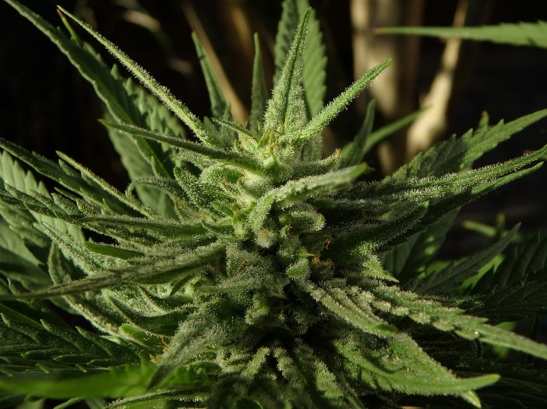
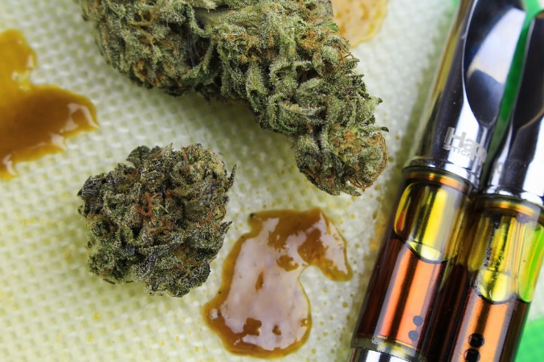
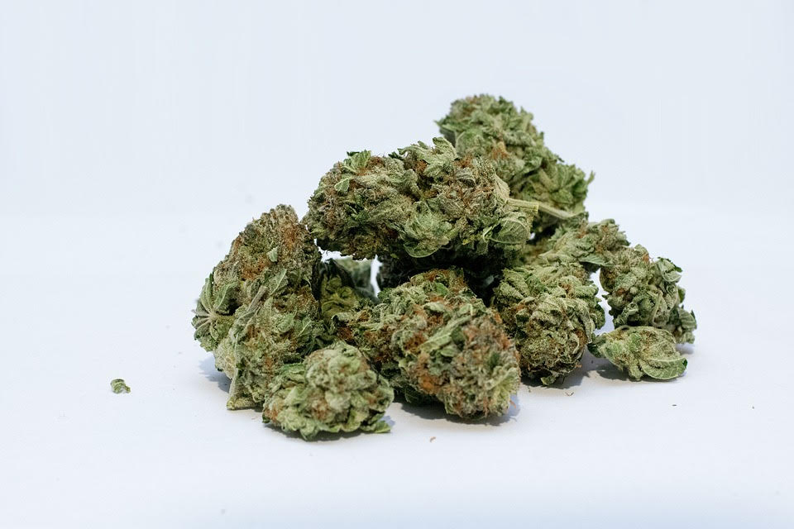
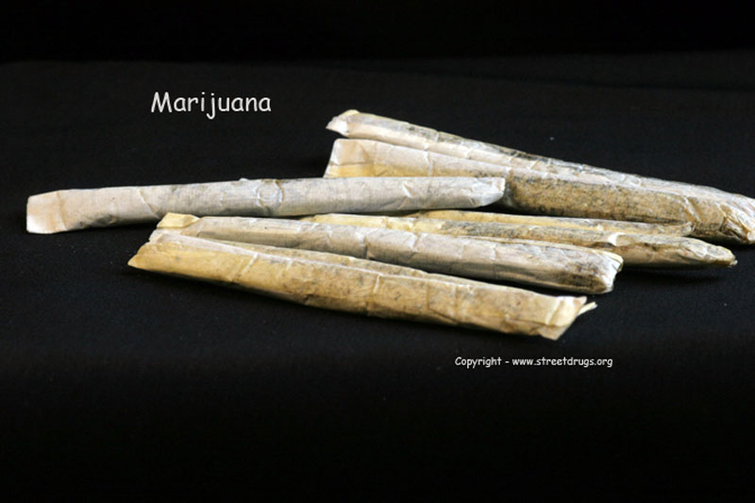
Trends in Cannabis Use
14th Annual FTA Drug and Alcohol Program
National Conference
April 2-4, 2019
Sean K. Oswald, Senior Associate, RLS & Associates, Inc.
Notes:
Title change based on c

Slide 2
AGENDA
Basic Information
Trends, Use, Demographics, etc.
Workplace Impacts
FAQs / Myth-busting

Slide 3
Basic Information
RLS & Associates, Inc.
Notes:
12

Slide 4
Basic Information
Marijuana: What is it?
Product of the cannabis (Sativa or Indica) plant
Contains THC and other compounds
THC is the main psychoactive chemical that produces the “high”
This Photo by Unknown Author is licensed under CC BY-SA
Notes:
12

Slide 5
Basic Information
Common Names: What are they?
This Photo by Unknown Author is licensed under CC BY-SA
This Photo by Unknown Author is licensed under CC BY-SA
Notes:
12

Slide 6
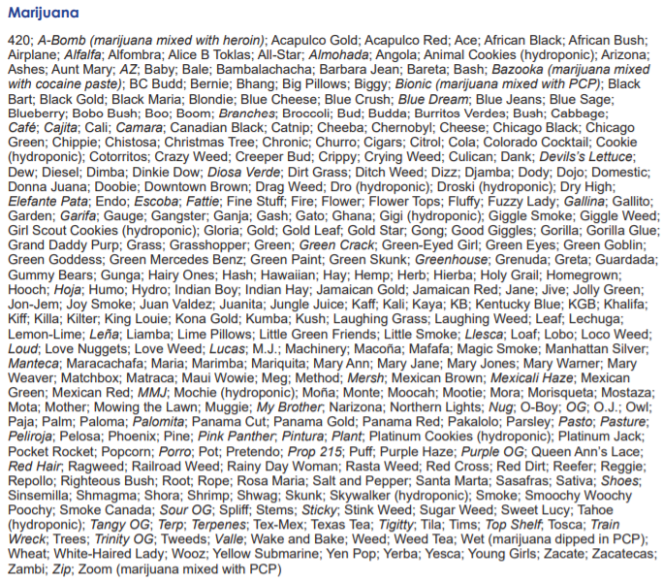
Basic Information
Common Names: What are they?
Notes:
12

Slide 7
Basic Information
Common Names: What are they?
Cannabis, Marijuana, Weed, Pot, and on and on and on and on……
Business industry leaning toward “Cannabis”
Differ based on demographics, geography, type of product, etc.
Curious observation:
Increase in legalization = Decrease in “Whacky” names
This Photo by Unknown Author is licensed under CC BY-SA
Notes:
12

Slide 8
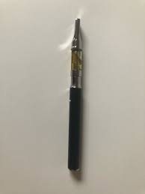
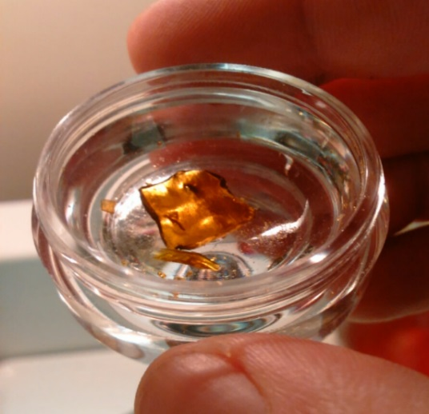
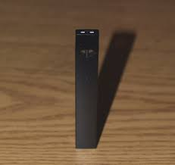
Basic Information
Common Names: Continued
Some new* popular vocabulary:
Shatter
THC extract product
Amber “glass-like” appearance
Vaping
Inhaling marijuana through vape pen
Dab, Dabbing (not the dance)
Inhaling concentrated cannabis oil
This Photo by Unknown Author is licensed under CC BY-SA
Notes:
12

Slide 9
Basic Information
Illicit THC Potency Over Time
1970 =
1995 =
2000 =
2005 =
2010 =
2015 =
Has THC in illicit marijuana gone UP or DOWN since 1970?
Notes:
12
13 states of decriminalized
Only 3 states have not done one of the following: (Idaho, South Dakota, Kansas)
Recreation
Medical
Decrim

Slide 10
Basic Information
Illicit THC Potency Over Time
1970 = <1%
1995 = ~ 4%
2000 = ~ 5%
2005 = ~ 8%
2010 = ~ 10%
2015 = ~ 13%
Has THC in illicit marijuana gone UP or DOWN since 1970?
Illicit THC Potency Over Time
Recreational and Medical THC products are regularly found to be 20% - 30% THC
THC concentrates can be 80%+ THC
Notes:
12
13 states of decriminalized
Only 3 states have not done one of the following: (Idaho, South Dakota, Kansas)
Recreation
Medical
Decrim

Slide 11
Basic Information
How Do People Use Marijuana?
Smoke
Joint, pipe, bong, blunt, etc.
Vaporize
Vaporizers, E-cigs, Vape-pens
Collect THC in vapor, which is then inhaled instead of smoke
Typically THC oil but can be leaf form as well
Edibles
Not just your **grandma’s** pot-brownie any more
Notes:
12
13 states of decriminalized
Only 3 states have not done one of the following: (Idaho, South Dakota, Kansas)
Recreation
Medical
Decrim

Slide 12
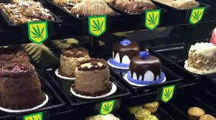
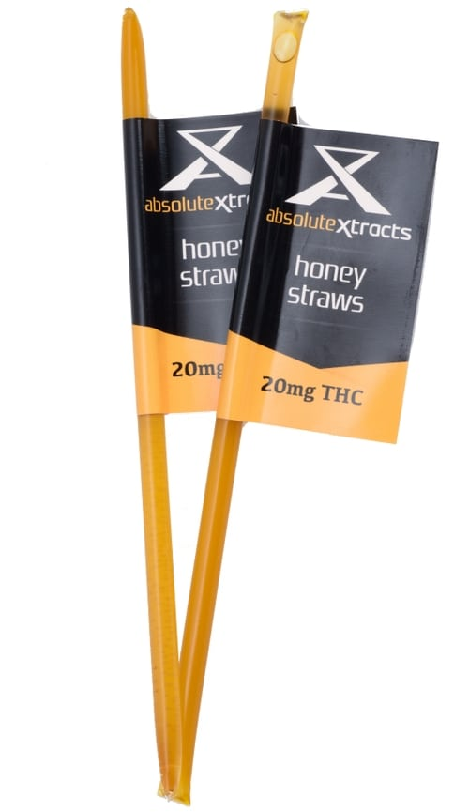
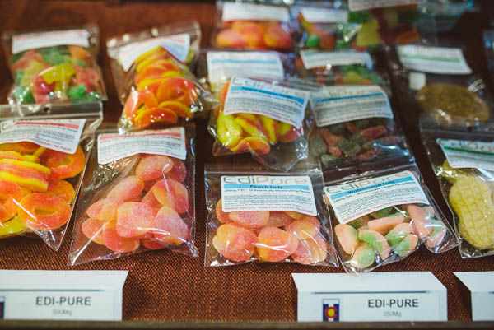
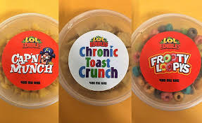
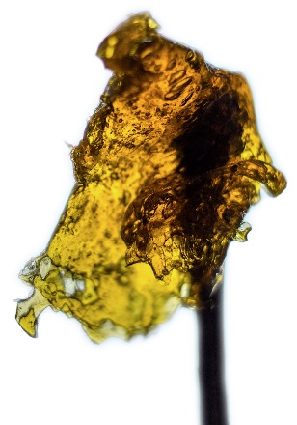
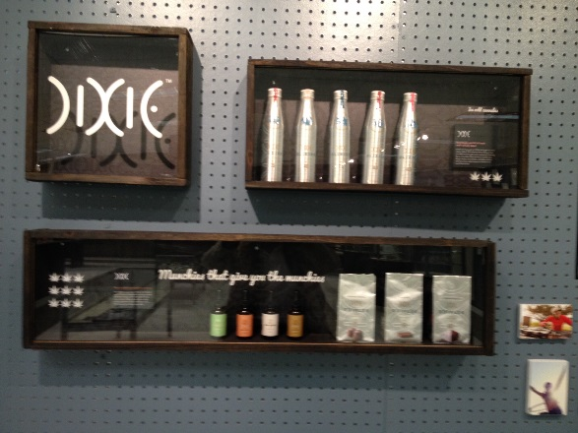
Basic Information
How Do People Use Marijuana?
Notes:
12
13 states of decriminalized
Only 3 states have not done one of the following: (Idaho, South Dakota, Kansas)
Recreation
Medical
Decrim

Slide 13
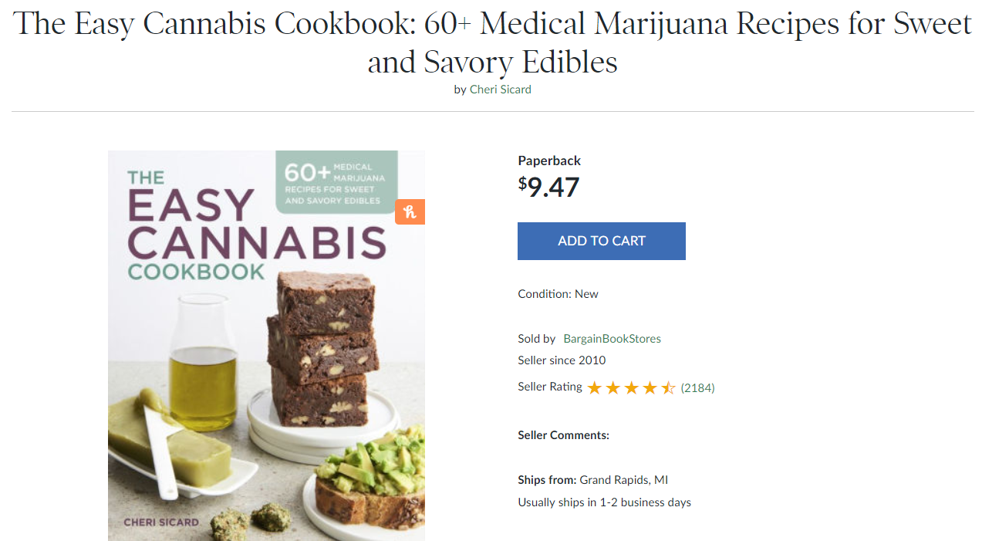
Basic Information
Notes:
12
13 states of decriminalized
Only 3 states have not done one of the following: (Idaho, South Dakota, Kansas)
Recreation
Medical
Decrim

Slide 14
Basic Information
Recreational vs. Medical vs. Decriminalized
What does “Recreational” Marijuana mean?
How many states have passed “Recreational”?
10, plus D.C.
What does “Medical” Marijuana mean?
How many states have passed “Medical”?
33, plus D.C., Guam, and Puerto Rico
What does “Decriminalized” Marijuana mean?
Notes:
12
13 states of decriminalized
Only 3 states have not done one of the following: (Idaho, South Dakota, Kansas)
Recreation
Medical
Decrim

Slide 15
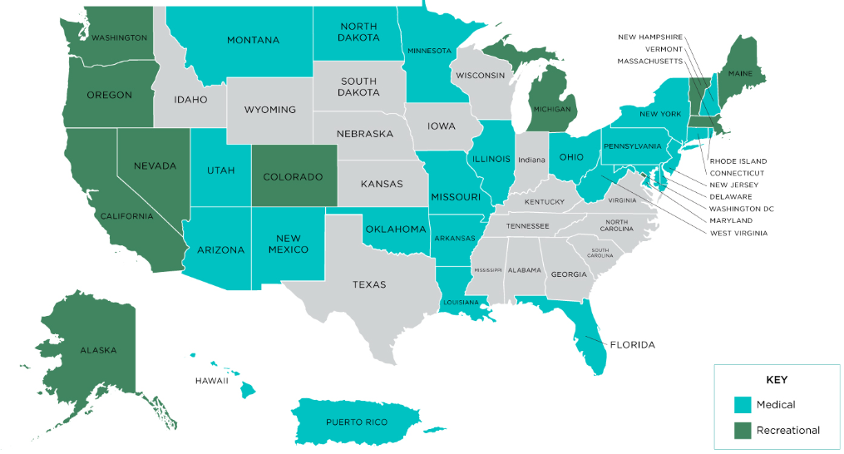
Basic Information
Recreational vs. Medical vs. Decriminalized
Decriminalized ONLY.
(Many other states have decriminalized in addition to other legalizations)
Notes:
12
13 states of decriminalized
Only 3 states have not done one of the following: (Idaho, South Dakota, Kansas)
Recreation
Medical
Decrim
Many states that have medical/Recreational have ALSO decriminalized, I have marked with a red dot the stat that has ONLY decriminalized (and has not also made it medical/recreational)

Slide 16
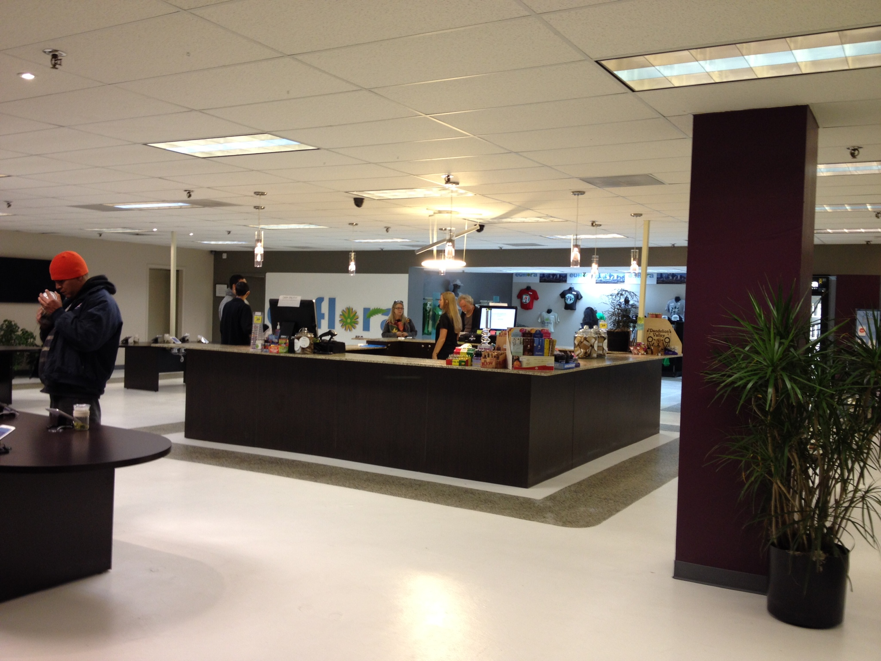
Notes:
12
13 states of decriminalized
Only 3 states have not done one of the following: (Idaho, South Dakota, Kansas)
Recreation
Medical
Decrim

Slide 17
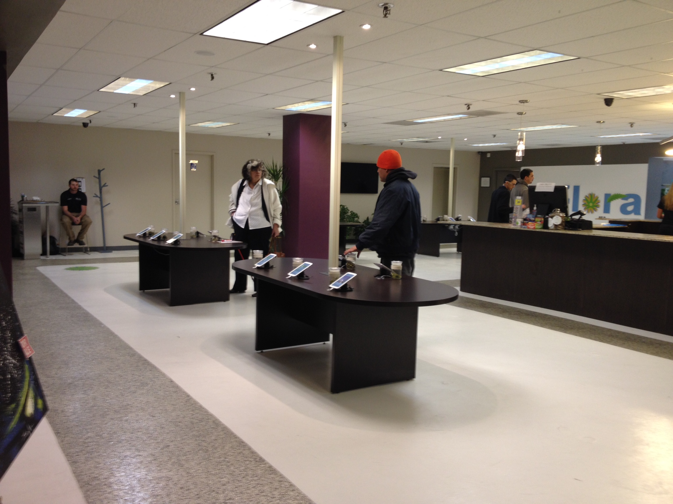
Notes:
12
13 states of decriminalized
Only 3 states have not done one of the following: (Idaho, South Dakota, Kansas)
Recreation
Medical
Decrim

Slide 18
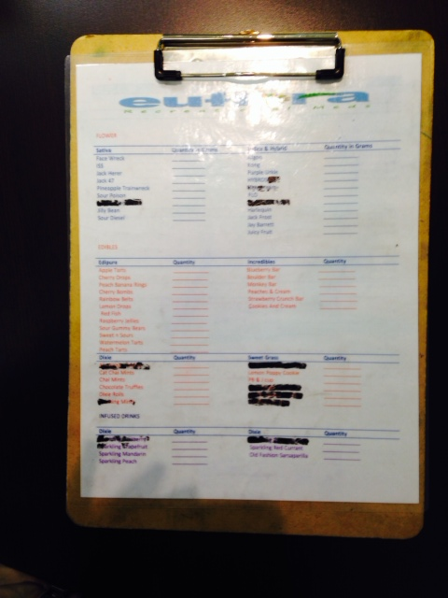
Notes:
12
13 states of decriminalized
Only 3 states have not done one of the following: (Idaho, South Dakota, Kansas)
Recreation
Medical
Decrim

Slide 19
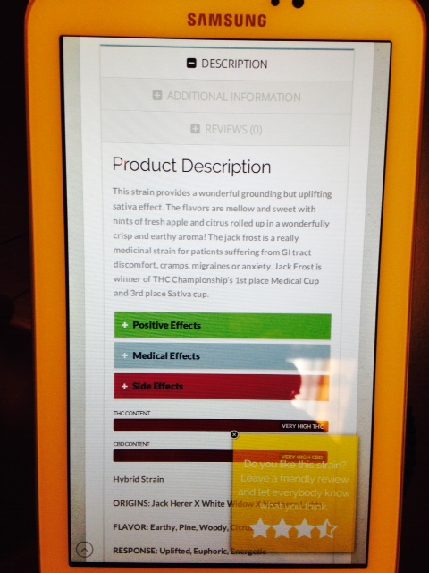
Notes:
12
13 states of decriminalized
Only 3 states have not done one of the following: (Idaho, South Dakota, Kansas)
Recreation
Medical
Decrim

Slide 20
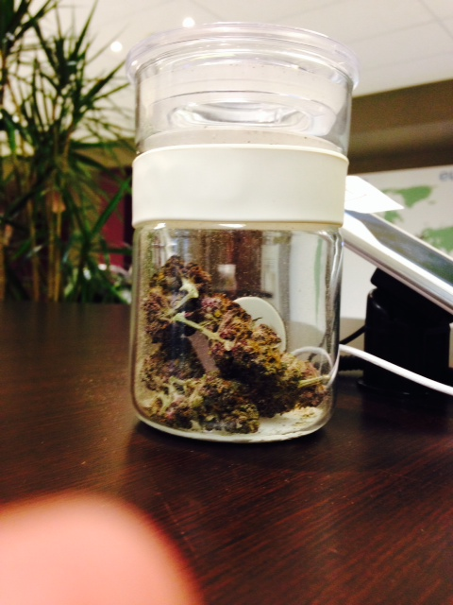
Notes:
12
13 states of decriminalized
Only 3 states have not done one of the following: (Idaho, South Dakota, Kansas)
Recreation
Medical
Decrim

Slide 21
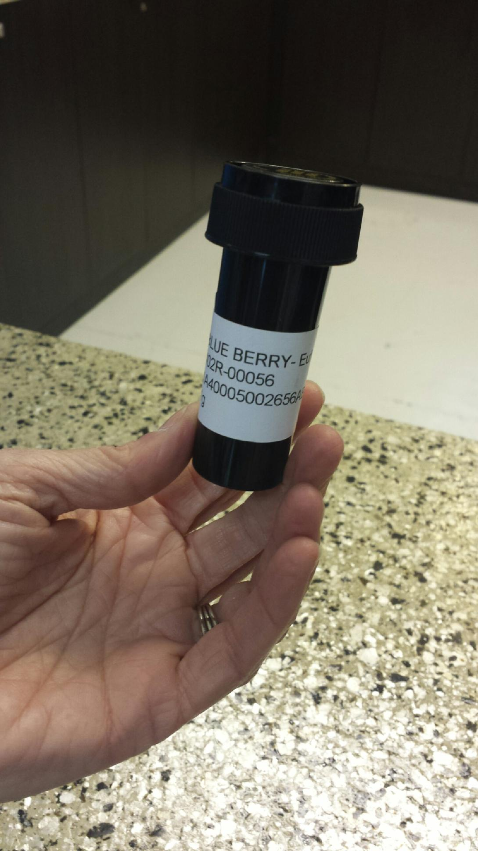
Notes:
12
13 states of decriminalized
Only 3 states have not done one of the following: (Idaho, South Dakota, Kansas)
Recreation
Medical
Decrim

Slide 22
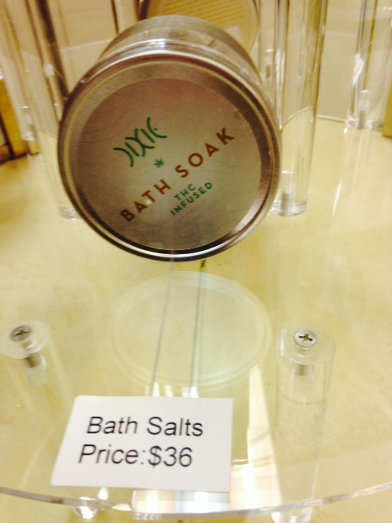
Notes:
12
13 states of decriminalized
Only 3 states have not done one of the following: (Idaho, South Dakota, Kansas)
Recreation
Medical
Decrim

Slide 23
Trends: Use, Products, Laws
RLS & Associates, Inc.
Notes:
12

Slide 24
Trends
Cannabis Use Trends / Prevalence
Notes:
12
13 states of decriminalized
Only 3 states have not done one of the following: (Idaho, South Dakota, Kansas)
Recreation
Medical
Decrim

Slide 25
Trends
Cannabis Use Trends / Prevalence
Notes:
12
13 states of decriminalized
Only 3 states have not done one of the following: (Idaho, South Dakota, Kansas)
Recreation
Medical
Decrim

Slide 26
Trends
Public Opinion on Legalizing Marijuana
Notes:
12
Source pew research center

Slide 27
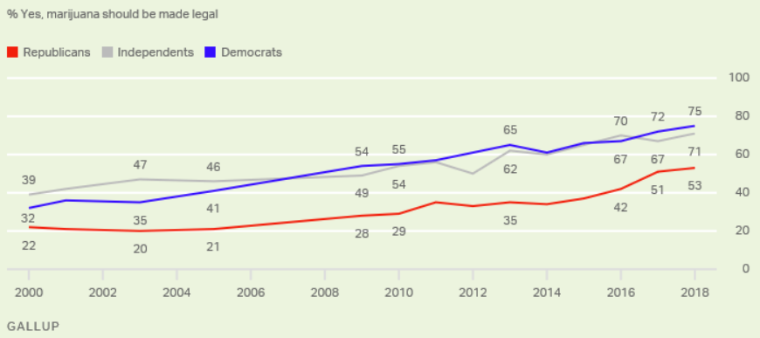
Trends
Majorities of All Political Groups Support
Notes:
12
Gallup poll October 2018

Slide 28
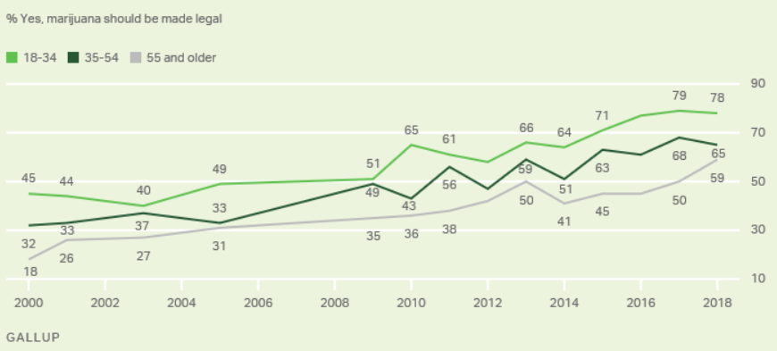
Trends
Majorities of All Age Groups Support
Notes:
12
Gallup poll October 2018

Slide 29
Trends
Majorities of All Regions Support
Notes:
12
Gallup poll October 2018

Slide 30
Trends
Product Trends
Vaping continues to rise
More than 30% of all cannabis sales in California in 2018 were vapes
Lower perceived health risk
Many state medical marijuana laws prohibit smoking marijuana (vaping often allowed)
Notes:
12
13 states of decriminalized
Only 3 states have not done one of the following: (Idaho, South Dakota, Kansas)
Recreation
Medical
Decrim

Slide 31
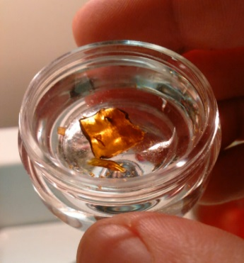
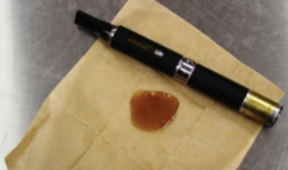
Trends
Product Trends
Vaping (continued)
THC concentrates:
Highly potent THC levels
common names include
Wax, shatter, 710, honey, budder
“dabs” “dabbing”
Notes:
12
13 states of decriminalized
Only 3 states have not done one of the following: (Idaho, South Dakota, Kansas)
Recreation
Medical
Decrim

Slide 32
Trends
Notes:
12
13 states of decriminalized
Only 3 states have not done one of the following: (Idaho, South Dakota, Kansas)
Recreation
Medical
Decrim

Slide 33
Trends
Product Trends
Edibles “From coffees to cooked meat, purees to puddings”
More and more varieties
Low THC dosage edibles marketed toward “Beginners”
Cannabis-infused products
Distillate Oils (no odor/taste)
Beverages
Notes:
12

Slide 34
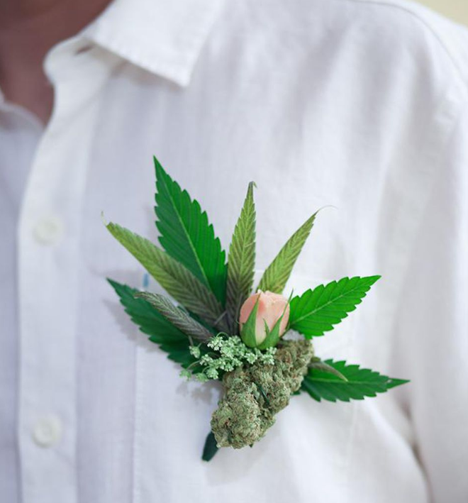
Trends
Misc.
“Weed Weddings”
Edibles
Cannabis bars
Gift bags
Designated areas for use
Notes:
12

Slide 35
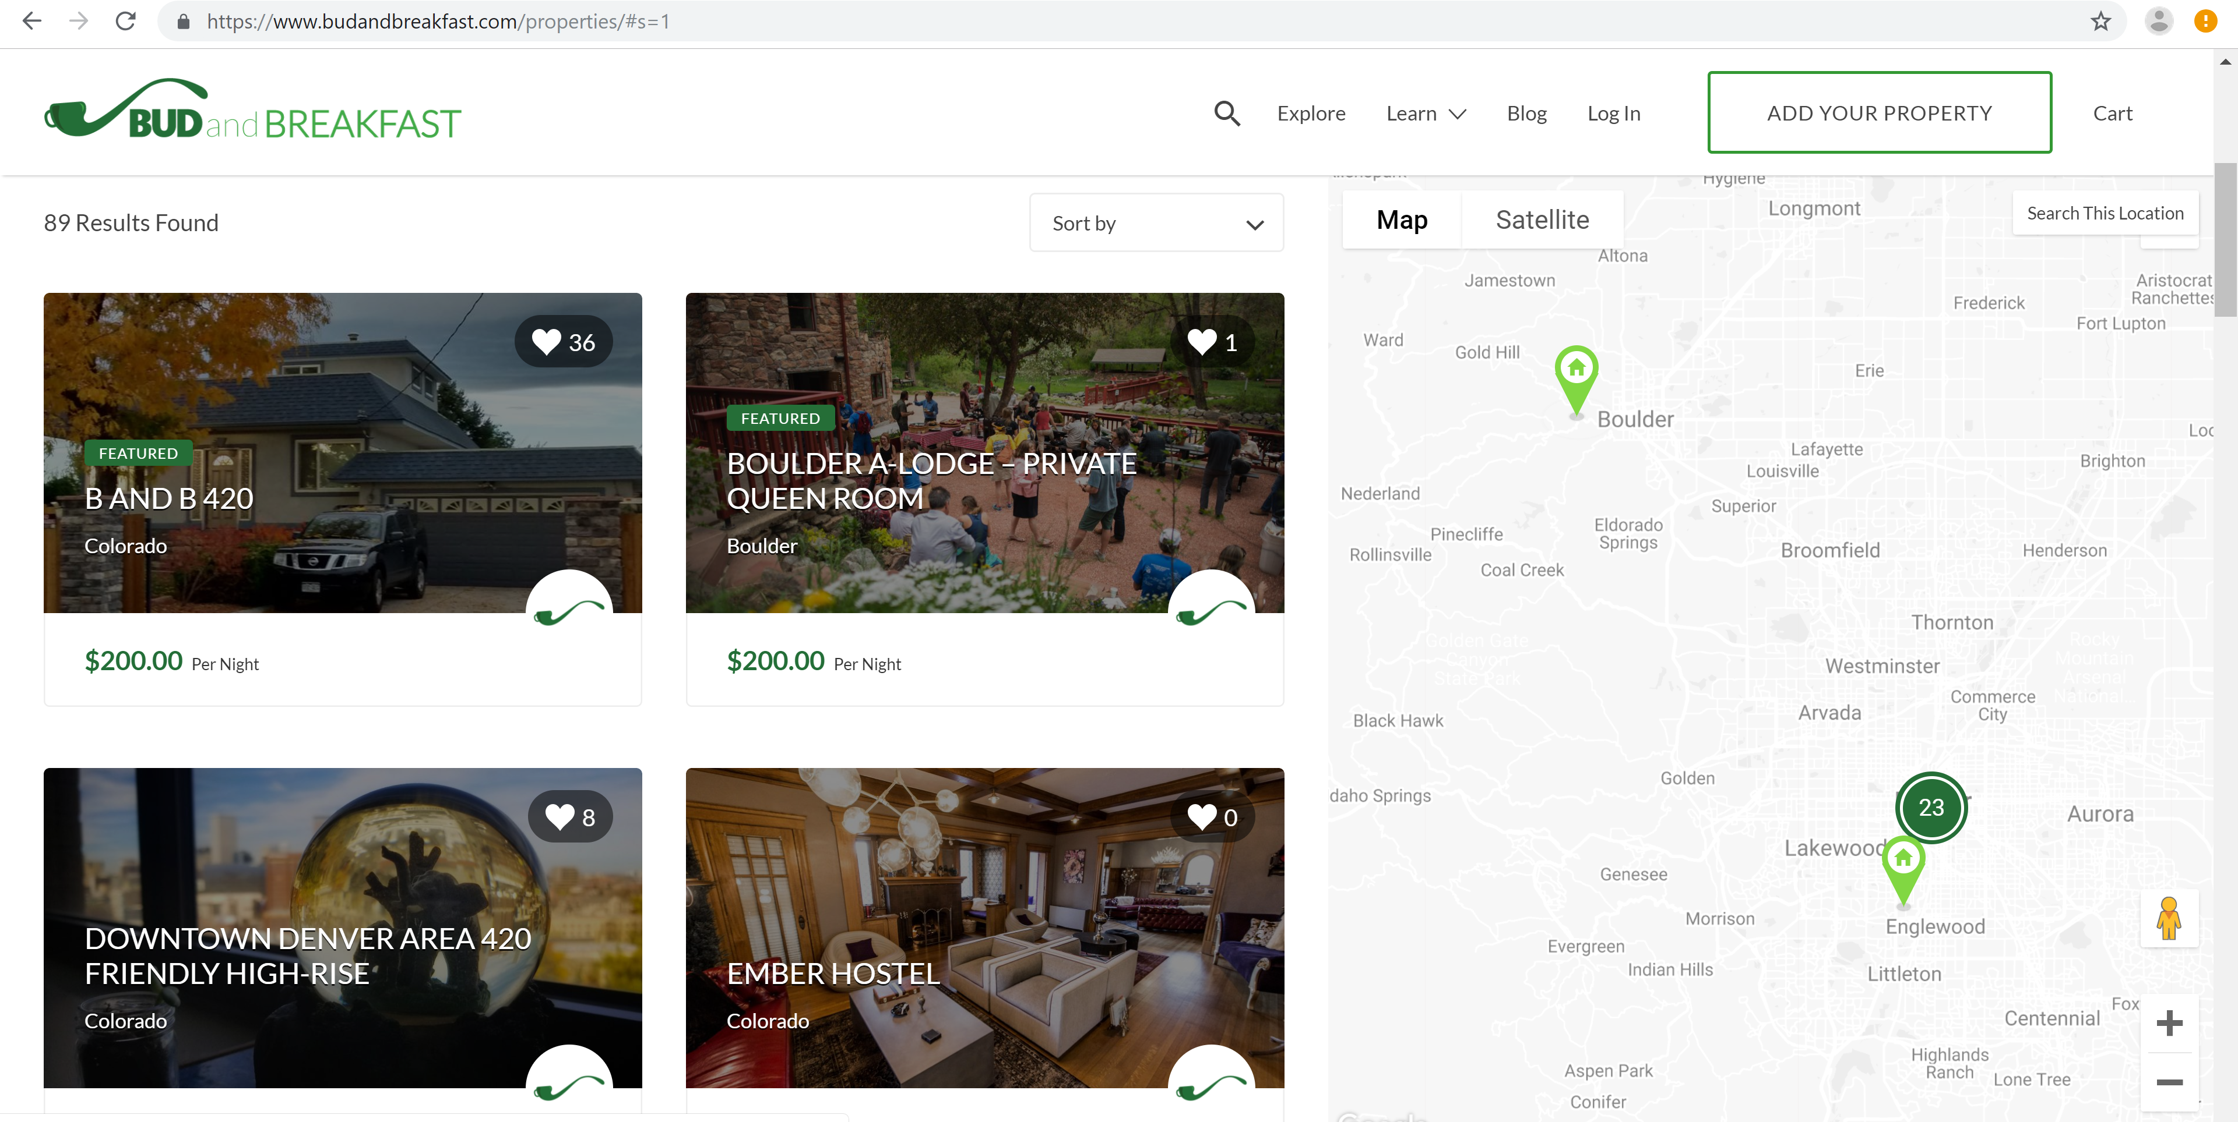
Trends
Misc.
“Bud and Breakfast”
www.budandbreakfast.com
Notes:
12

Slide 36
Workplace Impact
RLS & Associates, Inc.
Notes:
12

Slide 37
Workplace Impact
Federal vs. State
THC is still Federally illegal… USDOT is a Federal test
“Prescription” / medical recommendation for Marijuana
Will NOT save anyone from a USDOT positive test result
For USDOT testing, prescriptions must be consistent with the Federally mandated “Controlled Substances Act” (CSA)
Marijuana (THC) is Schedule 1 under CSA = CAN’T LEGALLY BE PRESCRIBED
Notes:
12

Slide 38
Workplace Impact
Employer Policies and Employee Education
USDOT tests for presence of drugs, NOT IMPAIRMENT
Make this VERY clear in your policies and in your employee training
Most employers and supervisors understand
We are seeing MANY employees/applicants who don’t get it
Employees have responsibility to avoid inadvertent consumption of THC edibles
Especially if living in recreational state
Notes:
12

Slide 39
Workplace Impact
Employer Policies and Employee Education
Over 50% of marijuana users surveyed say it is safe to drive high on marijuana
Research published in 2018
Anonymous survey of marijuana users across all 50 states
Older age and less education predicted beliefs that driving high was safe
More frequent users also more likely to say driving high is safe (the “expert” phenomena)
Notes:
12
Anonymous online survey; all 50 states; 54% respondents were male
“driving under the influence of cannabis. Cuttler, C., Sexton, M., Mischley, L. K. 2018. Cannabis Volume 1 (2). DOI: 10.26828/cannabis.2018.02.001

Slide 40
Workplace Impact
What about you?
The industry is seeing an increase in marijuana positivity rates on drug tests
What challenges/impacts are you experiencing in your workplace with marijuana/cannabis?
Notes:
12
Marijuana Positivity Increases 47% Since 2013

Slide 41
FAQs & Myth-busting
RLS & Associates, Inc.
Notes:
12

Slide 42
Cannabis
FAQs and Myth-Busting
“How much money are recreational cannabis sales bringing in?”
State | Recreational Sales (doesn’t include medical sales)
Alaska | 39.5 million
California | 2.75 billion
Colorado | 1.56 billion
Oregon | 777.6 million
Washington | 1 billion
Notes:
12

Slide 43
Cannabis
FAQs and Myth-Busting
“Just how much tax money are these states REALLY getting?”
Washington 2017:
Cannabis tax/fees collected = $319 million
Liquor tax/fees collected = $206 million
Colorado 2017:
Cannabis tax/fees collected = $247 million
Notes:
12

Slide 44
Cannabis
FAQs and Myth-Busting
“Legalizing marijuana will cause more kids to use and will cause kids to think it is less harmful”
From 1991 – 2006 the relationship between “perceived risk” and “prevalence of use” went up/down uniformly
i.e., if “perceived risk” goes down 2%, “prevalence of use” would go up a similar amount.
This trend changed in 2006 forward
In 2015, “perceived risk” went down over 11%, but “prevalence of use” only went up ~ 1%
Notes:
12
Source: Recent rapid decrease in adolescents' perception that marijuana is harmful, but no concurrent increase in use. https://www.ncbi.nlm.nih.gov/pubmed/29550624. Drug Alcohol Depend. 2018 May 1;186:68-74. doi: 10.1016/j.drugalcdep.2017.12.041. Epub 2018 Mar 1.

Slide 45
Cannabis
FAQs and Myth-Busting
“Are we close to being able to have a “pot-breathalyzer?”
Not really. At least not one that is validated and reliable enough to make any significant legislative/regulatory changes
Detection of acute cannabis intoxication:
How THC impairs us is different than how alcohol impairs us
Detection of impairment is different as well
Notes:
12
For example, alcohol impairment is very dose-specific and most people are similarly impaired at a minimum threshold
THC impairment can also be dose-specific, but it varies across users per-dose more than compared to alcohol
THC does not correlate well with impairment in our body
Impairment lasts 2 – 4 hours; however peak THC levels have declined 80-90% in our blood in only 1 hour

Slide 46
Questions?

